Slide 1
Transforming and Analyzing Data with SQL
Andrew Elliott

Slide 2
Project Goals
Ultimately, my goals can be summed up in one mission statement: To transform the data that has been made available to me into a dataset that can be relied on for delivering hard results and solid insights. This can be done by:
Removing duplicates
Standardizing values
Making sound judgment calls

Slide 3
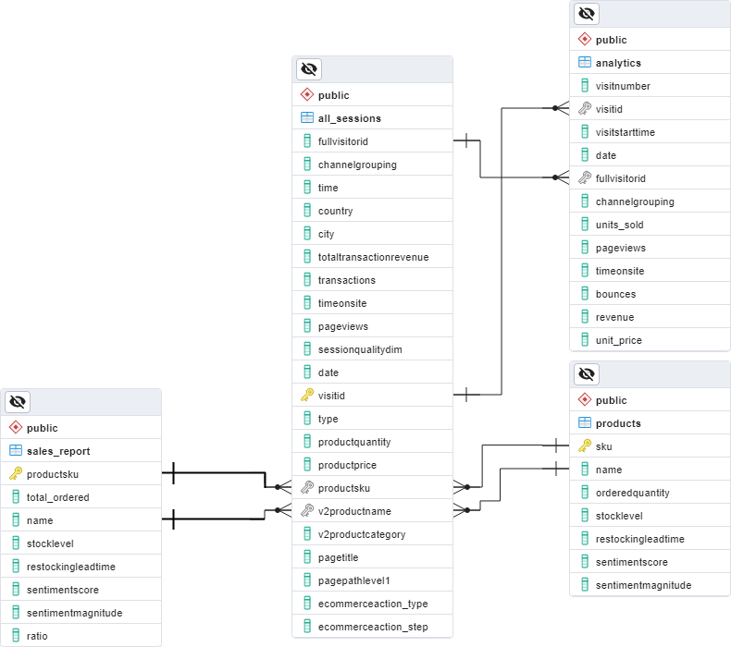
Step 1: Profiling
First, I needed to know what the tables all were! In other words, I needed to understand what data was contained in the five tables and figure out what was good and what wasn’t.
I also needed to figure out their relationships to one another.

Slide 4
Step 2: Data Validation
I kept three key main considerations in mind:
a. Data should be as complete as possible. In short, I ran queries to see if I had NULL values, verified that unused contents were actually unused (or else barely used), and so forth.
b. Data should be unique. If it isn't, then you run the risk if skewing or distorting any observations you make with the data available to you.
c. Data should be consistent. Typos should be cleared, value formatting standardized, and so on. Basically, we want everything to be comprehensible at a glance and to know that it will continue making sense.

Slide 5
Step 3: Data Cleaning
A simple 5-step process!
a. Remove irrelevant data (from the source)
b. Remove or filter duplicate data
c. Remedy data inconsistencies
d. Regulate data
e. Resolve issues with data gaps

Slide 6
Realizations - What I Could Do
Question 1: Which items have been purchased the most, sorted by total price for all items?
Question 2: What are the “total_orders” for each category of “channelgrouping”? What do the results suggest about how effective one avenue of access to the site is for selling products to people?
Question 3: How many orders in each category were made in Q2 of 2017 (from May 1st to July 31st)?
LHL Questions: I could assess which products were popular in which regions, determine the top-selling products by country, and even break down orders by country as percentages of a total.

Slide 7
Step 4: QA
Important Considerations:
a. Specific value checks, especially for NULLs
b. Checking for invalid labels or categories
c. Utilize data assertions

Slide 8
If I had more time…
Table normalization
Utilization of views and other strategies for organizing data
Tackling the analytics table

Slide 9
All in all, it was a great learning experience!

